Slide 1
Welcome to Skykomish Community Church
a Word preaching,
people loving community

Slide 2
Song(s)

Slide 4
ANNOUNCEMENTS
Next Communion: May 7th
Next Potluck: Mother’s Day, May 14th
Cathy & Tony’s 46th Anniversary: May 7th
Offering: place in box on the north wall in the rear of the sanctuary, use PayPal donate button on website, or mail to:
Skykomish Community Church
PO Box 56
Skykomish, WA 98288

Slide 5
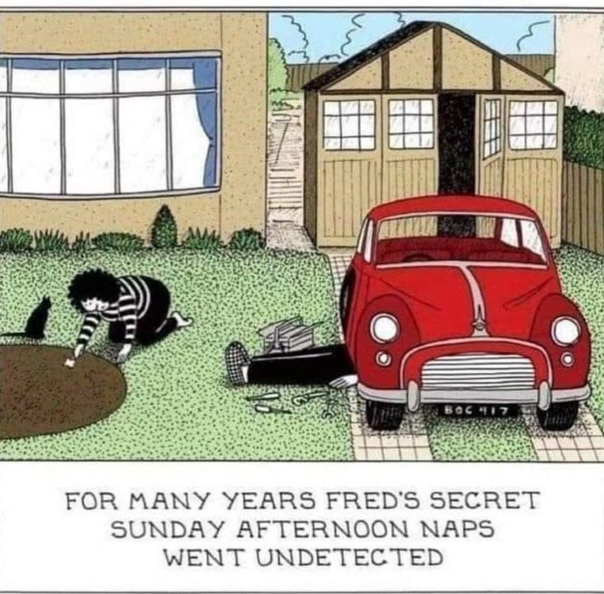
ANNOUNCEMENTS

Slide 6
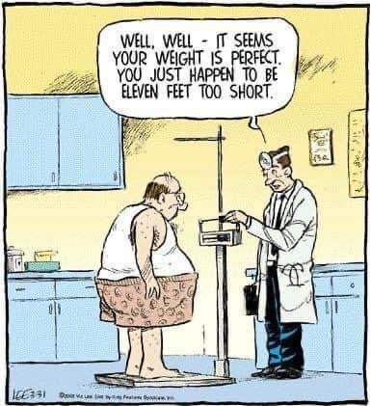
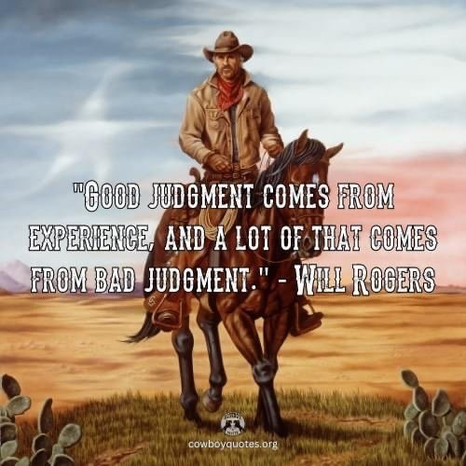
ANNOUNCEMENTS

Slide 7
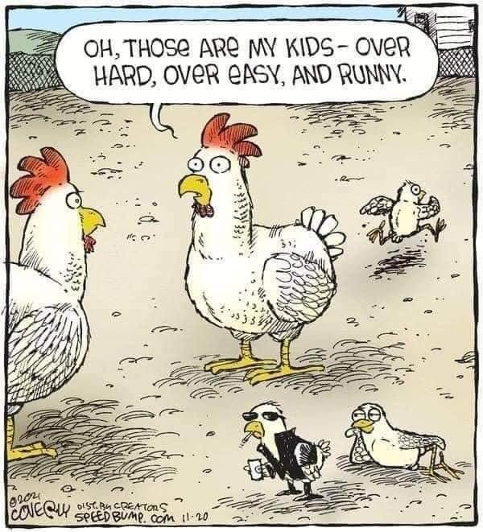
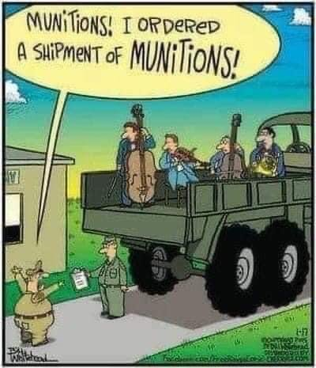
ANNOUNCEMENTS

Slide 8
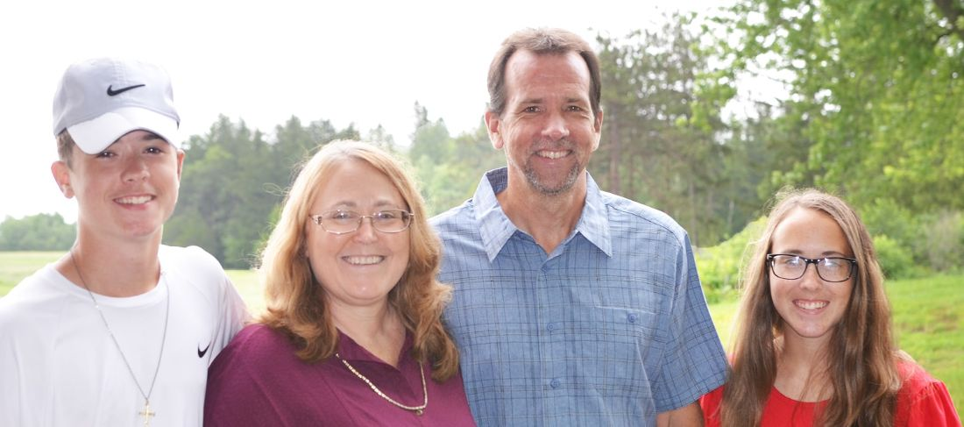
Prayer Spotlight
Eric & Helen Roselund; Pendleton, NY
Christian Faith Chapel; Great Lakes District
We are between Buffalo and Niagara Falls, NY. The church has been with Village Missions since 1968; at that time, it was much more rural than it is today. While some farms are still in our area, many subdivisions have sprouted up over the years. Our community is very diverse. We are blessed with a wonderful church family and pray that we will be salt and light to others.

Slide 9
Prayer Spotlight
Eric & Helen Roselund; Pendleton, NY
Christian Faith Chapel; Great Lakes District
PRAYER REQUESTS:
We praise God for the many servants in our church family. We are especially encouraged by the young adults who are willing to serve.
Pray for our youth group, kids club, and Bible studies.
Pray for the Gospel message to reach into this community through us.

Slide 10
Song

Slide 12
ANNOUNCEMENTS
Matthew 23:37 (NIV)
“Jerusalem, Jerusalem, you who kill the prophets and stone those sent to you, how often I have longed to gather your children together, as a hen gathers her chicks under her wings, and you were not willing.

Slide 13
Song

Slide 15
Mark 12:1-12
Speaking in a Parable

Slide 16
Mark 12:1-12(NIV)
Jesus then began to speak to them in parables: “A man planted a vineyard. He put a wall around it, dug a pit for the winepress and built a watchtower. Then he rented the vineyard to some farmers and moved to another place. At harvest time he sent a servant to the tenants to collect from them some of the fruit of the vineyard. But they seized him, beat him and sent him away empty-handed. Then he sent another servant to them; they struck this man on the head and treated him shamefully. He

Slide 17
Mark 12:1-12(NIV)
sent still another, and that one they killed. He sent many others; some of them they beat, others they killed.
“He had one left to send, a son, whom he loved. He sent him last of all, saying, ‘They will respect my son.’
“But the tenants said to one another, ‘This is the heir. Come, let’s kill him, and the inheritance will be ours.’ So they took him and killed him, and

Slide 18
Mark 12:1-12(NIV)
threw him out of the vineyard.
“What then will the owner of the vineyard do? He will come and kill those tenants and give the vineyard to others. Haven’t you read this passage of Scripture:
“‘The stone the builders rejected
has become the cornerstone;
the Lord has done this,
and it is marvelous in our eyes’?”

Slide 19
Mark 12:1-12(NIV)
Then the chief priests, the teachers of the law and the elders looked for a way to arrest him because they knew he had spoken the parable against them. But they were afraid of the crowd; so they left him and went away.

Slide 20
Matthew 23:37 (NIV)
“Jerusalem, Jerusalem, you who kill the prophets and stone those sent to you, how often I have longed to gather your children together, as a hen gathers her chicks under her wings, and you were not willing.

Slide 21
Matthew 21:28-46 (NIV)
“What do you think? There was a man who had two sons. He went to the first and said, ‘Son, go and work today in the vineyard.’
“‘I will not,’ he answered, but later he changed his mind and went.
“Then the father went to the other son and said the same thing. He answered, ‘I will, sir,’ but he did not go.
“Which of the two did what his father wanted?”

Slide 22
Matthew 21:28-46 (NIV)
“The first,” they answered.
Jesus said to them, “Truly I tell you, the tax collectors and the prostitutes are entering the kingdom of God ahead of you. For John came to you to show you the way of righteousness, and you did not believe him, but the tax collectors and the prostitutes did. And even after you saw this, you did not repent and believe him.

Slide 23
Matthew 21:28-46 (NIV)
“Listen to another parable: There was a landowner who planted a vineyard. He put a wall around it, dug a winepress in it and built a watchtower. Then he rented the vineyard to some farmers and moved to another place. When the harvest time approached, he sent his servants to the tenants to collect his fruit.
“The tenants seized his servants; they beat one, killed another, and stoned a third. Then he sent other servants to them, more than the first time,

Slide 24
Matthew 21:28-46 (NIV)
and the tenants treated them the same way. Last of all, he sent his son to them. ‘They will respect my son,’ he said.
“But when the tenants saw the son, they said to each other, ‘This is the heir. Come, let’s kill him and take his inheritance.’ So they took him and threw him out of the vineyard and killed him.
“Therefore, when the owner of the vineyard comes, what will he do to those tenants?”

Slide 25
Matthew 21:28-46 (NIV)
“He will bring those wretches to a wretched end,” they replied, “and he will rent the vineyard to other tenants, who will give him his share of the crop at harvest time.”
Jesus said to them, “Have you never read in the Scriptures:
“‘The stone the builders rejected has become the cornerstone; the Lord has done this, and it is marvelous in our eyes’?

Slide 26
Matthew 21:28-46 (NIV)
“Therefore I tell you that the kingdom of God will be taken away from you and given to a people who will produce its fruit. Anyone who falls on this stone will be broken to pieces; anyone on whom it falls will be crushed.”
When the chief priests and the Pharisees heard Jesus’ parables, they knew he was talking about them. They looked for a way to arrest him, but they were afraid of the crowd because the people held that he was a prophet.

Slide 28
I cast all my cares upon You.
I lay all of my burdens
Down at Your feet.
And anytime that I don’t know
What to do,
I will cast all my cares upon You.

Slide 30
Numbers 6:24-26 (NIV)
The LORD bless you and keep you; the LORD make his face shine on you and be gracious to you; the LORD turn his face toward you and give you peace.

Slide 32
Ephesians 3:20-21 (NIV)
Now to him who is able to do immeasurably more than all we ask or imagine, according to his power that is at work within us, to him be glory in the church and in Christ Jesus throughout all generations, for ever and ever! Amen.

